Slide 1
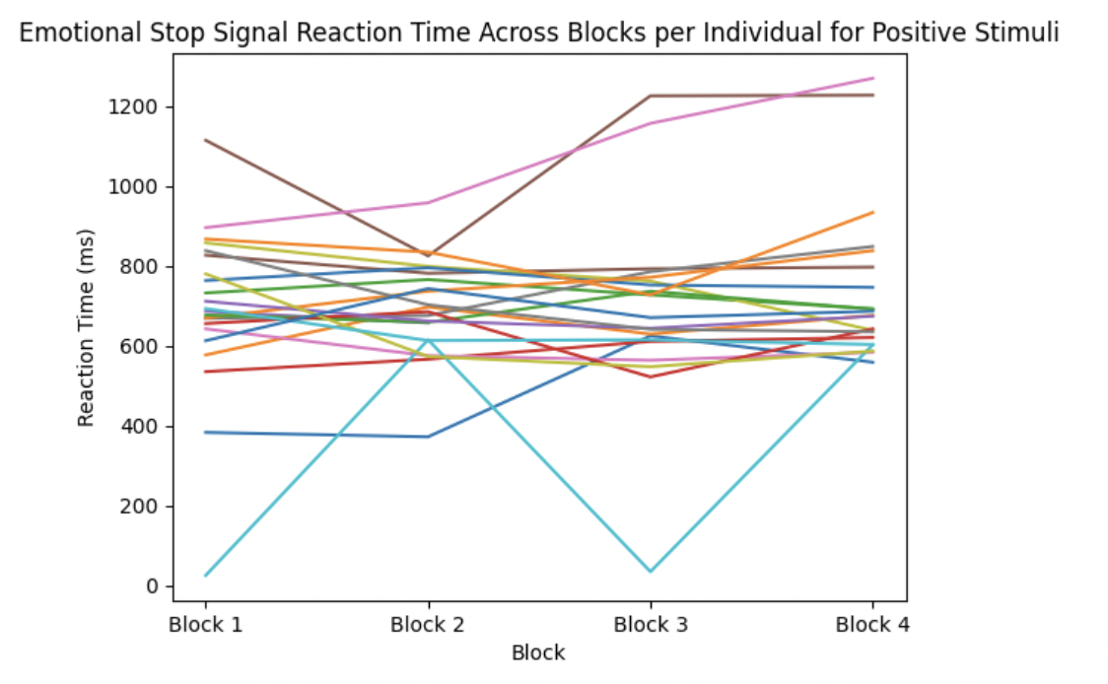
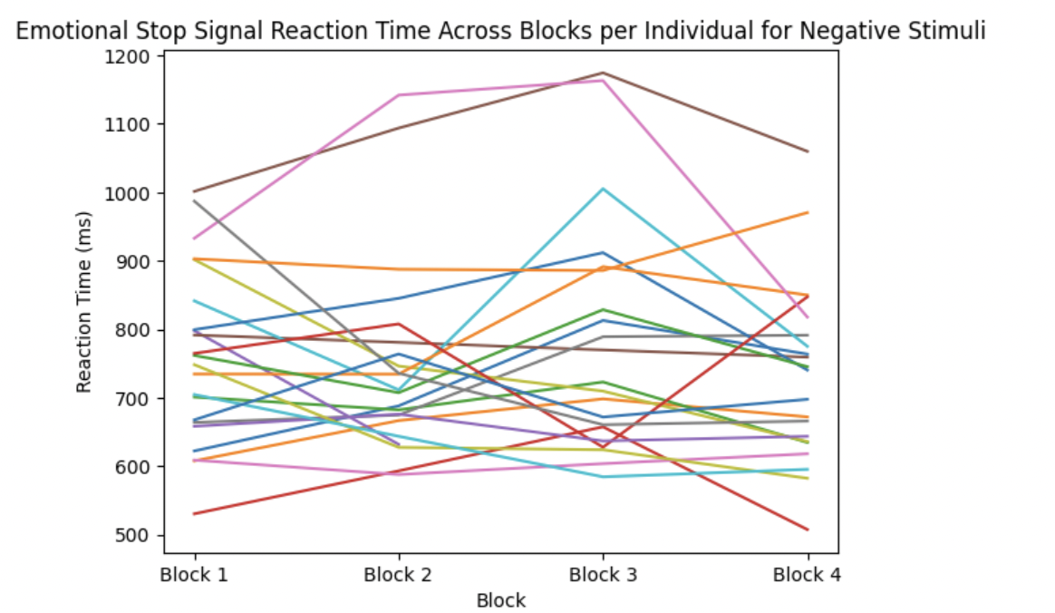

The Effects of Emotionally-Salient Stimuli in Stop-Signal Tasks
Nandini A. Rajgopal B.A., Sooyeon Kim, JD Allen PhD, Sheri Johnson PhD
INTRODUCTION
Spearman’s correlation | SSRT | ESSRT (neg)
ESSRT (neg) | -0.213
ESSRT (pos) | -0.377 | 0.589
RESULTS
Stop-signal task (SST) scores and related measures are among the most powerful neurocognitive correlates of psychopathology trans-diagnostically.
A growing body of work suggests the importance of emotion in disrupting cognitive processes, or “hot” cognitive control.
Here, we begin to evaluate an emotional stop-signal task (ESST) against the well-known SST.
SSRT, ESSRT-positive and ESSRT-negative are all statistically separable.
Pilot data suggests that neutral and negative scores are showing a differential profile.
There is little correlation between ESSRT-positive and psychopathology indices.
All p-values > .28
METHODS
Spearman’s correlation | Depression | Euphoria | Dysphoria
SST | 0.027 | -0.160 | 0.125
ESST (neg) | -0.235 | 0.236 | -0.230
ESST (pos) | -0.028 | 0.018 | -0.089
DISCUSSION
Sample: 23 undergraduate students
SST:
Each trial begins with a fixation screen (+ sign)
Participants respond to the arrow presented on the screen during each trial, by pressing the arrow key on the keyboard indicating its direction, except when they hear the “stop-signal”.
“Go” trials: The correct response involves a key press
“Stop” trials: Inhibit response
Stop-signal occurs with adaptive timing based off participant’s performance.
ESST:
Each trial begins with a fixation screen (+ sign)
Participants respond to the picture presented on the screen during each trial, by pressing the green labeled key (the ‘F’ key) if the picture is judged as positive, and the red labeled key (the ‘J’ key) if the picture is judged as negative.
Similar to the SST, the participants are instructed to inhibit their response when they hear the “stop-signal”
Pictures: from the IAPS and include XX blocks , which vary in the number of positive images or negative images.
Stop-signal occurs with adaptive timing based off participant’s performance
Our analyses use the calculated variable stop-signal reaction time (SSRT) as an indirect measure of response-inhibition latency.
As expected, performance on the SST, ESST-negative & ESST-positive are statistically separable.
Early pilot data suggests that the neutral and negative scores are showing differential links to depression, dysphoria, and euphoria, although in counter-intuitive directions.
There is little evidence that positive stimuli show links with mood disorder syndrome scores, which is in line with current research that positive stimuli has little effect on cognition.
We plan to gather data from fifty more individuals to further look into these effects.
All p-values > .28
REFERENCES
Verbruggen, F., Aron, A. R., Band, G. P., Beste, C., Bissett, P. G., Brockett, A. T., Brown, J. W., Chamberlain, S. R., Chambers, C. D., Colonius, H., Colzato, L. S., Corneil, B. D., Coxon, J. P., Dupuis, A., Eagle, D. M., Garavan, H., Greenhouse, I., Heathcote, A., Huster, R. J., Jahfari, S., … Boehler, C. N. (2019). A consensus guide to capturing the ability to inhibit actions and impulsive behaviors in the stop-signal task. eLife, 8, e46323. https://doi.org/10.7554/eLife.46323

